Slide 1
The Opening of the Pacific
On the NOAA Age of the Ocean Floor map.
They say a picture is worth a thousand words.
Here are eight thousand unspoken words to start a conversation.

Slide 2
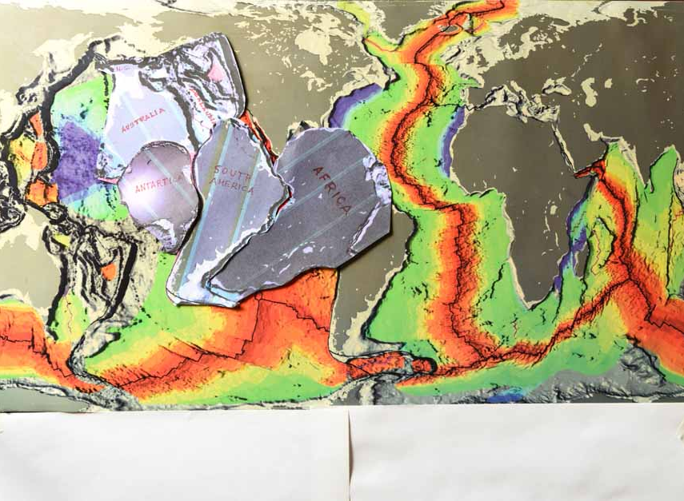
2. Expansion likely began when Zealandia was part of Australia.
Notes:
2. Expansion likely began when Zealandia was part of Australia.

Slide 3
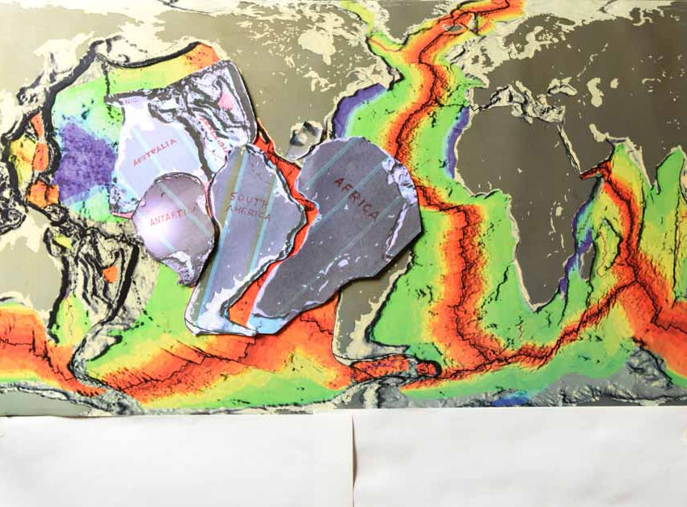
Notes:
3. Here, part of Mexico, Central America, Cuba. And the Caribbean Islands were tucked into the Gulf.

Slide 4
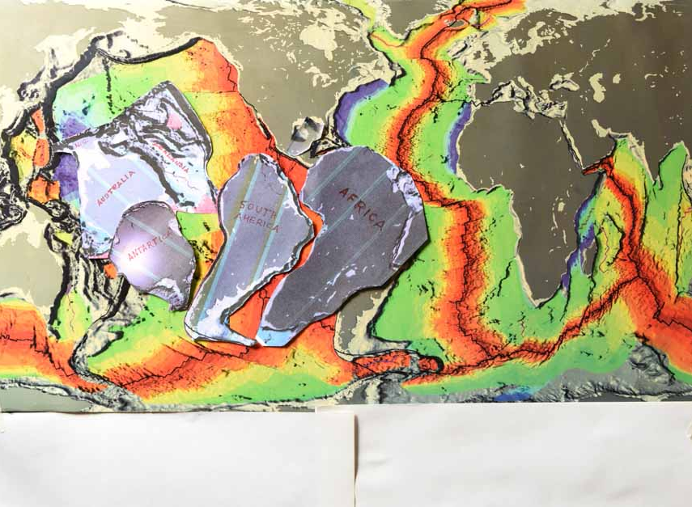
Notes:
4. The expanding floor of the Pacific was filling with basalt.

Slide 5
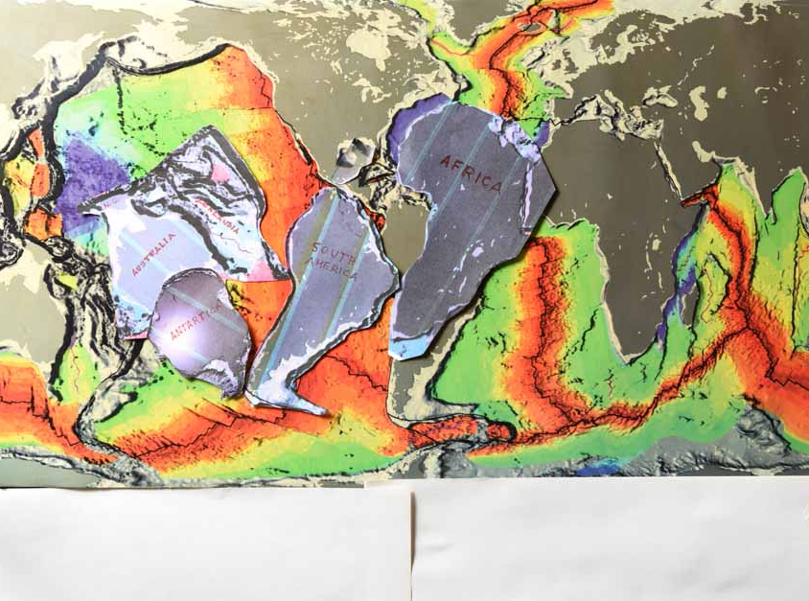
Notes:
5. Africa parting North America.

Slide 6
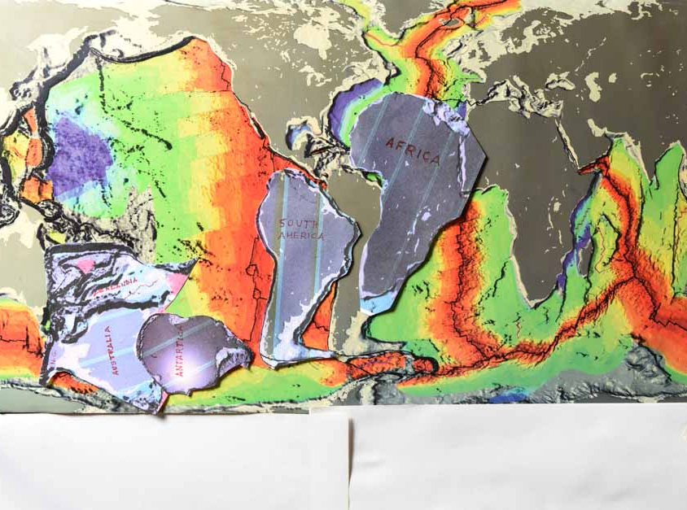
Notes:
5. Unfurling at the Gulf of Mexico.

Slide 7
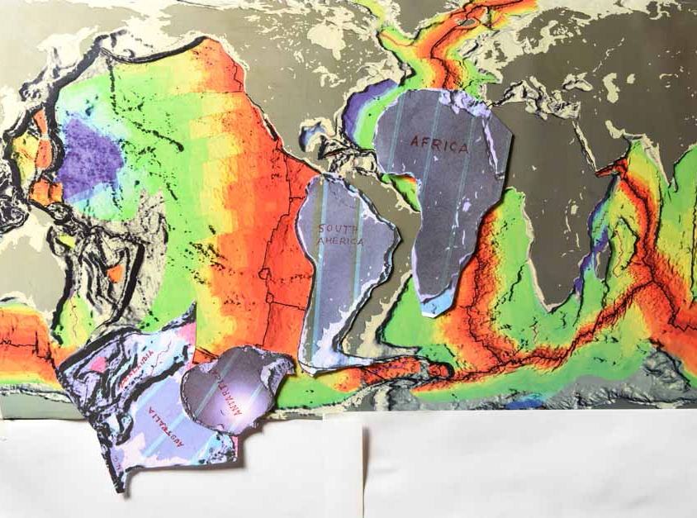
Notes:
6. Earth around 120 MYA.

Slide 8
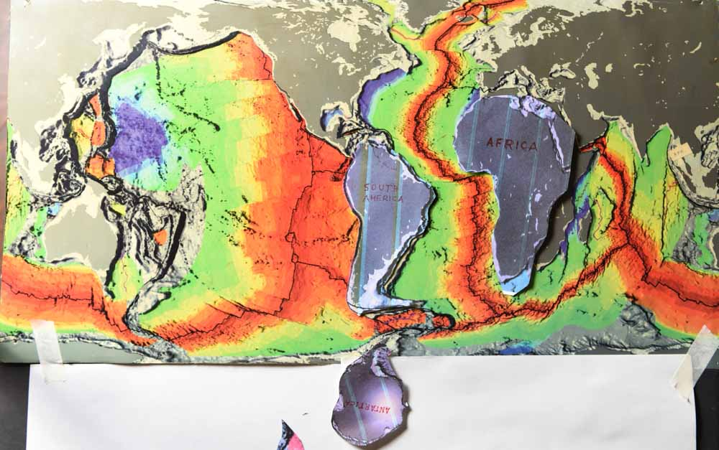
Notes:
7. Earth around 75 MYA.

Slide 9
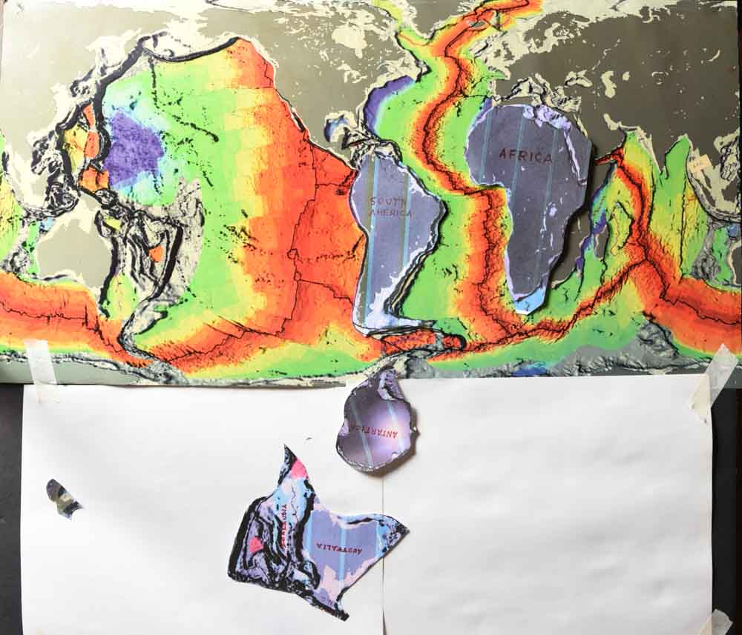
Notes:
9. The continents proceeding toward present positions.

Slide 10
A few notes
1. An IGE graph indicates accelerating expansion began around 200 million years ago. This expansion likely began when Zealandia was part of Australia and Venezuela was attached to Baja California.
2. 200 MYA, the lower part of Mexico, Central America, and the Caribbean Islands were tucked in and subsequently unfurled into the Gulf of Mexico.
3. The big blue blob on the NOAA map resulted from filling the space Australia and Zealandia vacated.
4. These eight pictures indicate where the Pacific opened and generally, the relative positions of the continents as the Earth grew and expanded its radius.

